Slide 1
Power Consumption Prediction

Slide 2
Introduction
Aim: The primary aim of this project is to develop a machine learning model that can accurately predict power consumption in Zone 3 of a Moroccan renewable energy company's operations in Agadir.

Slide 3
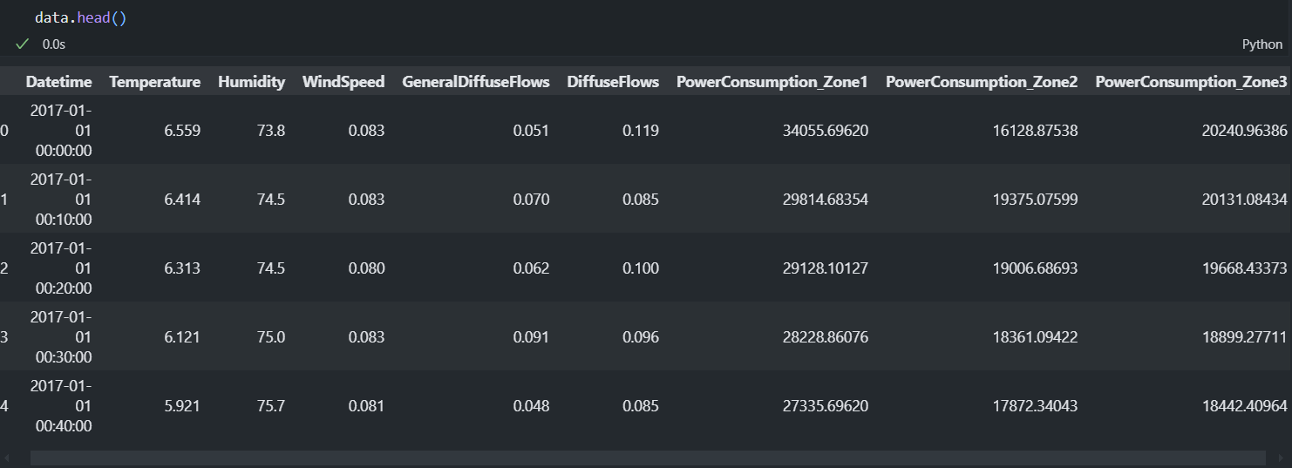
Dataset Collection
Sample dataset in CSV format was available.

Slide 4
Features of Dataset
Datetime | The date and time of the recording
Temperature | The Temperature in Celsius
Humidity | The concentration of water vapor in the air
WindSpeed | The speed of the wind in kilometers per hour
GeneralDiffuseFlows | The measurement of how much emissions gases diffuse into the broader atmosphere
DiffuseFlows | The measurement of how much emissions gases diffuse into the local atmosphere
PowerConsumption_Zone1 | The power consumption in Kilowatt-Hours in Power Zone 1
PowerConsumption_Zone2 | The power consumption in Kilowatt-Hours in Power Zone 2
PowerConsumption_Zone3 | The power consumption in Kilowatt-Hours in Power Zone 3

Slide 5
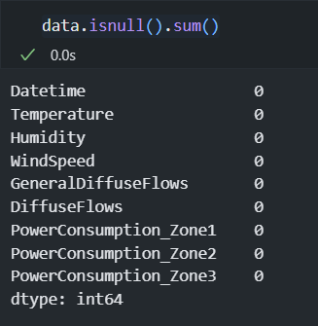
Data Preprocessing
Dealing with the Null Values – Can significantly impact the performance and accuracy of machine learning models.
Objective: To ensure data completeness and integrity before proceeding with analysis or modeling.
Findings: The dataset contains no missing values across all columns.

Slide 6
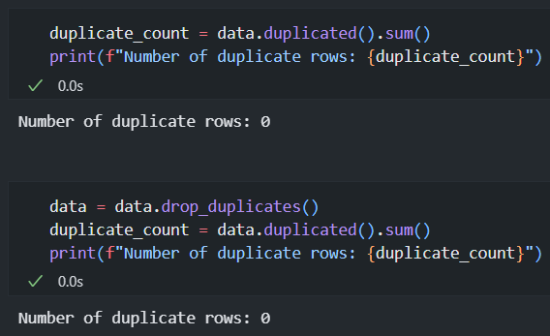
Data Preprocessing
Handling Duplicate Values and Null Values
Data Quality: Duplicate values/Null values can introduce errors and inconsistencies in your data, leading to inaccurate results and unreliable analysis.
Efficiency: Removing duplicates/Nulls can improve the efficiency of your data processing and analysis tasks, as you'll be working with a smaller dataset.
Model Performance: Duplicate values/Null values can affect the performance of machine learning models. For example, if a model is trained on a dataset with duplicates, it might learn to overfit to the repeated patterns, leading to poor generalization.
Data Interpretation: Duplicate values/Null values can make it difficult to interpret the results of your analysis. For instance, if you're counting the number of unique customers, duplicates would inflate the count.

Slide 7
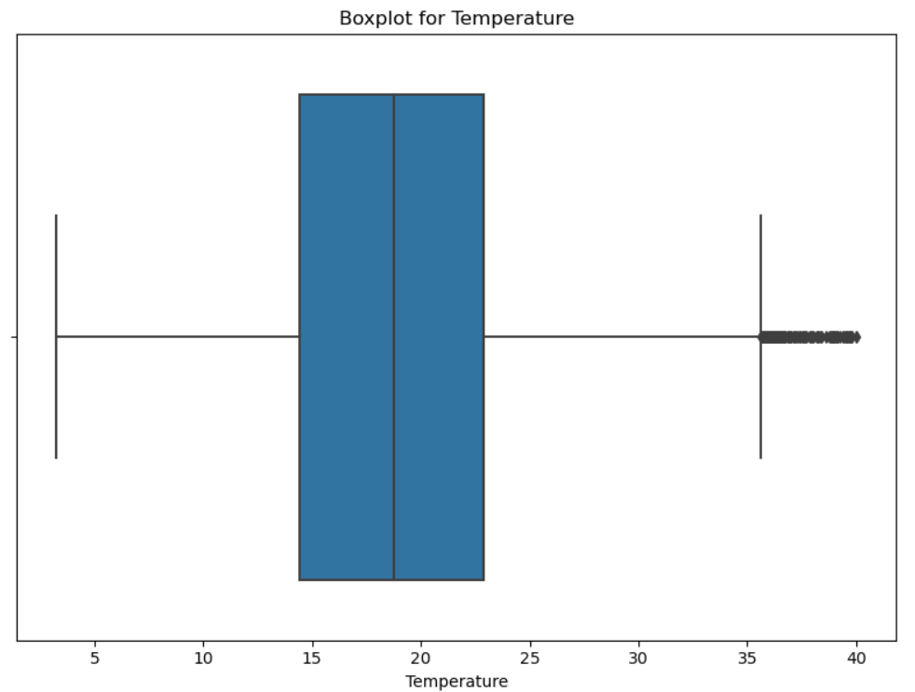
Exploratory Data Analysis
The vertical line within the box represents the median value. In this case, the median temperature appears to be around 17-18 degrees.
Temperature Distribution: The temperature data is skewed to the right, with a longer tail on the higher end. This indicates that there were more instances of higher temperatures compared to lower temperatures.
Outliers: The presence of outliers suggests that there might have been some extreme weather events or anomalies in the data.
Central Tendency: The median temperature is around 17-18 degrees, which gives a sense of the typical temperature.
Variability: The IQR provides information about the spread of the middle 50% of the data. A larger IQR would indicate greater variability in temperature.

Slide 8
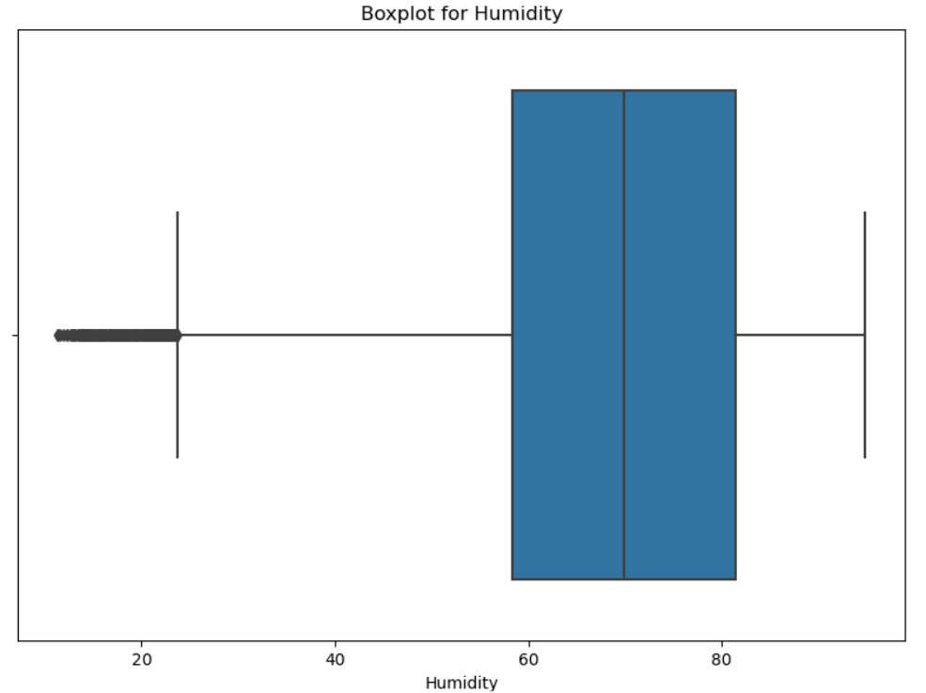
Exploratory Data Analysis
The vertical line within the box represents the median value. In this case, the median humidity appears to be around 60%.
Humidity Distribution: The humidity data appears to be slightly skewed to the left, with a longer tail on the lower end. This indicates that there were more instances of lower humidity compared to higher humidity.
Outliers: The presence of outliers on the lower end suggests that there might have been some unusually dry conditions.
Central Tendency: The median humidity is around 60%, which gives a sense of the typical humidity level.
Variability: The IQR provides information about the spread of the middle 50% of the data. A larger IQR would indicate greater variability in humidity.

Slide 9
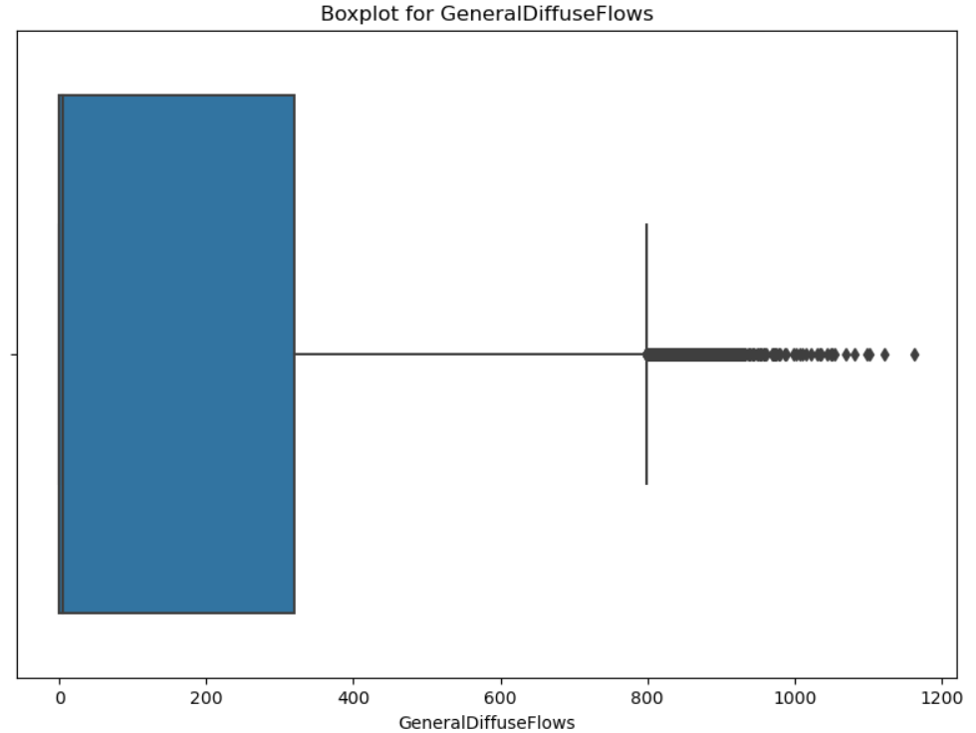
EDA
The vertical line within the box represents the median value. In this case, the median General Diffuse Flow appears to be around 200.
Whiskers:
The lines extending from the box are called whiskers. They typically represent 1.5 times the IQR.
In this case, the whiskers extend from around 0 to 800.
Outliers:
The individual dots beyond the whiskers are considered outliers. These are data points that are significantly different from the majority of the data.
In this case, there are a few outliers on the higher end of the General Diffuse Flows, indicating that there might have been some unusually high values.

Slide 10
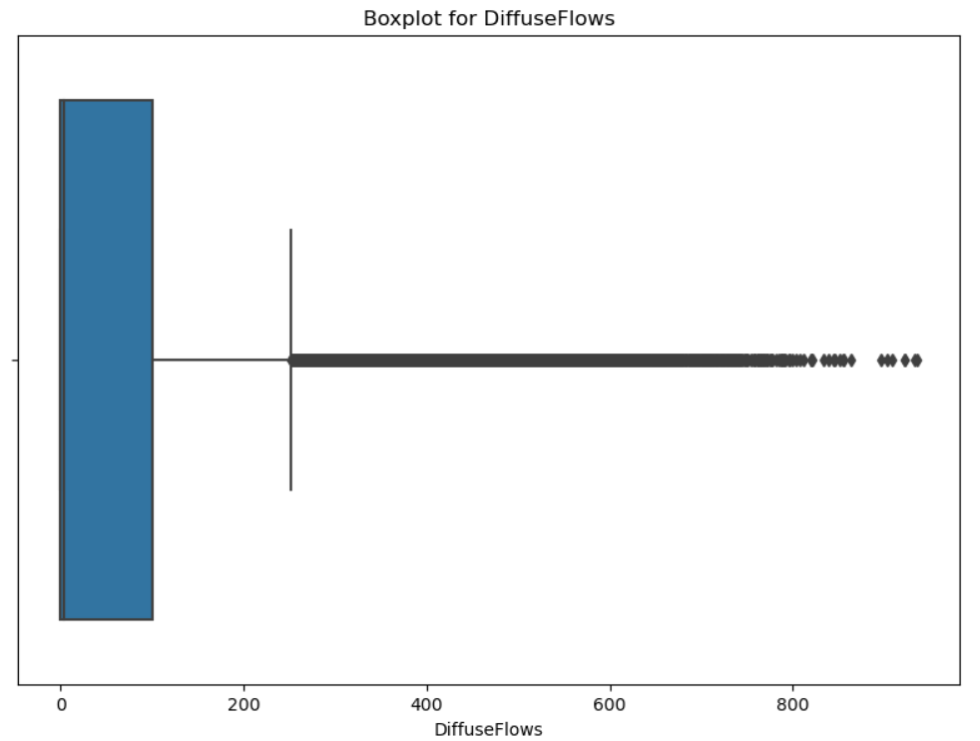
EDA
The vertical line within the box represents the median value. In this case, the median Diffuse Flow appears to be around 0.
Whiskers:
The lines extending from the box are called whiskers. They typically represent 1.5 times the IQR.
In this case, the whiskers extend from around 0 to 200.
Outliers:
The individual dots beyond the whiskers are considered outliers. These are data points that are significantly different from the majority of the data.
In this case, there are numerous outliers on the higher end of the Diffuse Flows, indicating that there might have been some unusually high values.

Slide 11
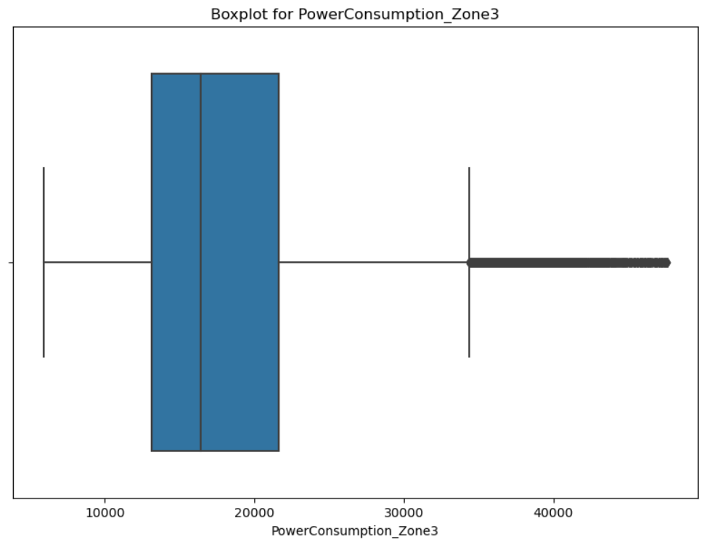
EDA
The vertical line within the box represents the median value. In this case, the median PowerConsumption_Zone3 appears to be around 15,000.
In this case, the whiskers extend to around 30,000.
Outliers:
The individual dots beyond the whiskers are considered outliers. These are data points that are significantly different from the majority of the data.
In this plot, there are numerous outliers on the higher end of the PowerConsumption_Zone3, indicating that there might have been some unusually high power consumption values.

Slide 12
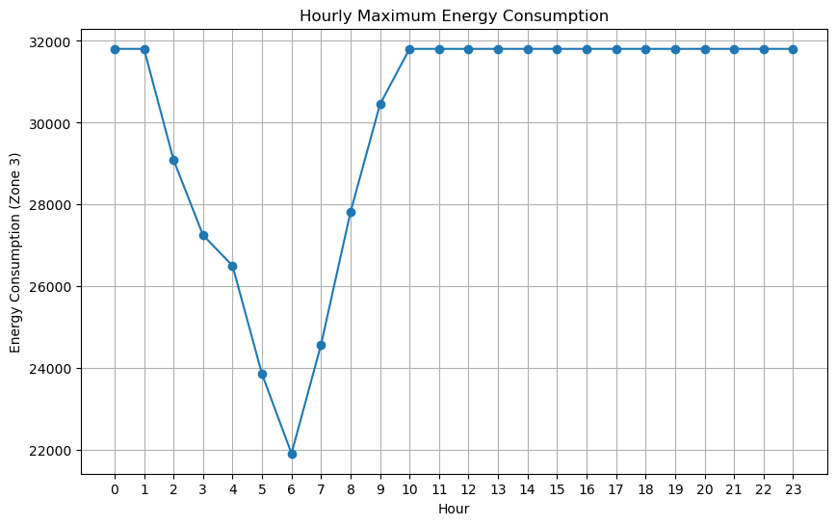
EDA: Insights from the Hourly Maximum Energy Consumption(zone3) Plot

Slide 13
EDA: Analyzing the violin plot
The plot shows a distinct peak in energy consumption around hours 7 and 11, suggesting a significant increase in demand during these periods.
After the peak, the energy consumption remains relatively stable, with minor fluctuations throughout the day.
Early Morning: There's a gradual increase in energy consumption from the early hours of the day.
Peak Hours: The highest energy consumption is observed between hours 7 and 11, indicating a period of high demand, likely due to activities like industrial operations or residential usage.
Afternoon and Evening: After the peak, the energy consumption starts to decrease, possibly due to a decline in industrial activity or residential usage.
Nighttime: Energy consumption remains relatively low during the night hours, indicating a reduction in demand.

Slide 14
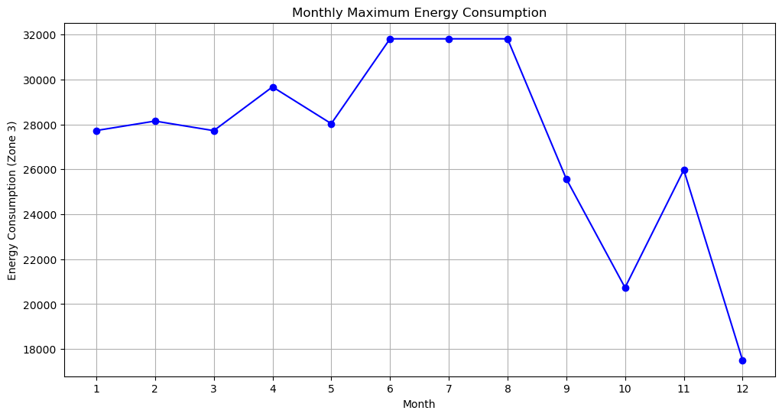
EDA: Insights from the Hourly Maximum Energy Consumption(zone3) Plot

Slide 15
EDA: Insights from the Hourly Maximum Energy Consumption(Zone3) Plot.
The plot shows a clear seasonal pattern in energy consumption, with peaks during certain months and troughs in others.
There's a significant increase in energy consumption from month 1 to month 6, followed by a decrease from month 6 to month 12.
Peak Months: The highest energy consumption is observed in months 6 and 7, indicating a period of high demand, likely due to factors like increased cooling needs during summer months.
Trough Months: The lowest energy consumption is observed in months 1, 2, and 12, suggesting reduced demand during colder months.
Seasonal Variation: The overall trend suggests a strong seasonal influence on energy consumption, with higher demand during warmer months and lower demand during colder months.

Slide 16
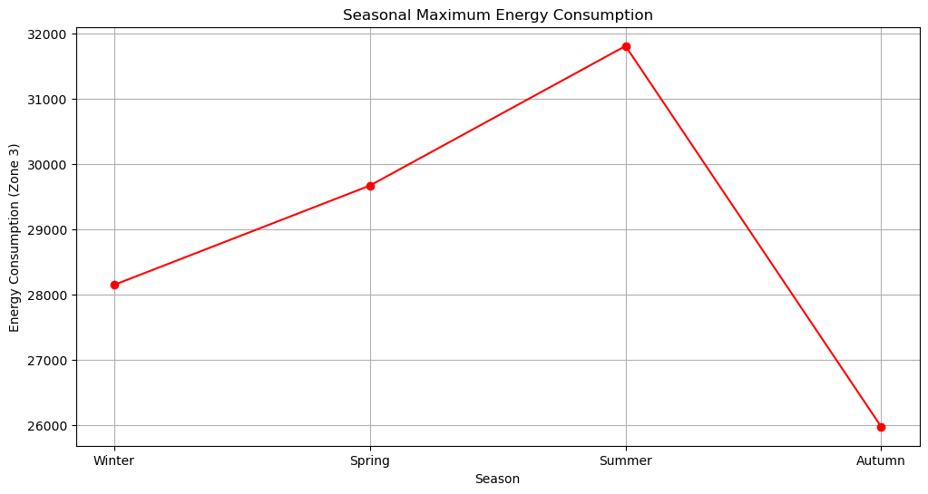
EDA: Insights from the Seasonal Maximum Energy Consumption (Zone3) Plot

Slide 17
EDA: Insights from the Seasonal Maximum Energy Consumption (Zone3) Plot
The plot shows a clear seasonal pattern in energy consumption, with a peak during the summer season and a trough during the winter season.
Peak Season: The highest energy consumption occurs during the summer season, indicating increased demand, likely due to factors like higher temperatures and increased cooling needs.
Trough Season: The lowest energy consumption is observed during the winter season, suggesting reduced demand, possibly due to lower temperatures and decreased heating needs.
Seasonal Variation: The overall trend highlights a significant seasonal influence on energy consumption, with higher demand during warmer months and lower demand during colder months.

Slide 18
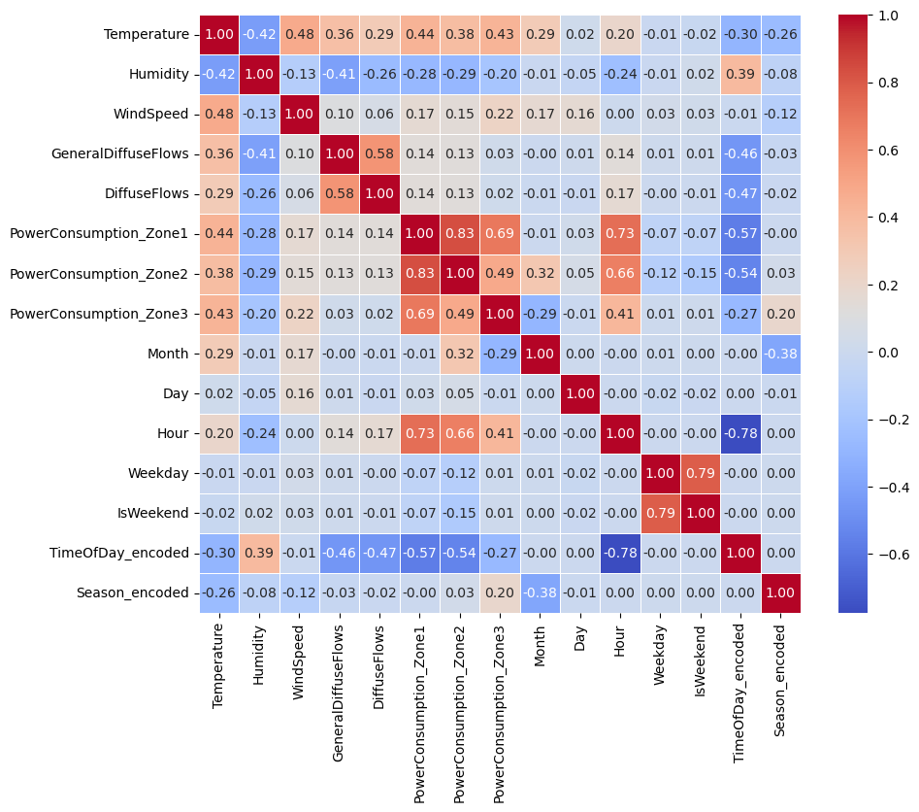
Correlation Heatmap

Slide 19
Insights from the Heatmap: PowerConsumption_Zone3
Positive Correlations:
Temperature: A moderate positive correlation suggests that higher temperatures tend to be associated with higher power consumption in Zone 3. This could be due to increased demand for cooling during warmer periods.
Wind Speed: A weak positive correlation suggests that higher wind speeds might slightly increase power consumption. This could be due to the operation of wind turbines or other wind-related energy sources.
PowerConsumption_Zone1 and PowerConsumption_Zone2: Strong positive correlations with these zones indicate that their energy consumption patterns are closely related to Zone 3, possibly due to shared factors like weather conditions or overall energy demand.
Negative Correlations:
TimeOfDay_encoded: A strong negative correlation suggests that lower time-of-day values (e.g., early morning) are associated with lower power consumption in Zone 3. This aligns with typical daily patterns of energy usage.
Season_encoded: A moderate negative correlation suggests that certain seasons (e.g., winter) might be associated with lower power consumption in Zone 3. This could be due to factors like reduced cooling needs during colder months.

Slide 20
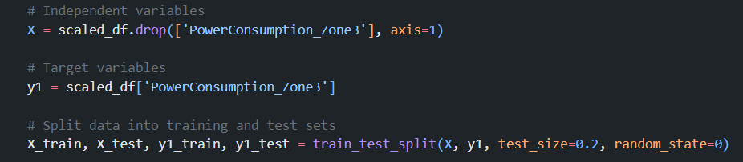
Predictive Modelling
Data is split as 70% for training and 30% for testing.
( Tried 80% and 20% split, minimal changes in the accuracy.)

Slide 21
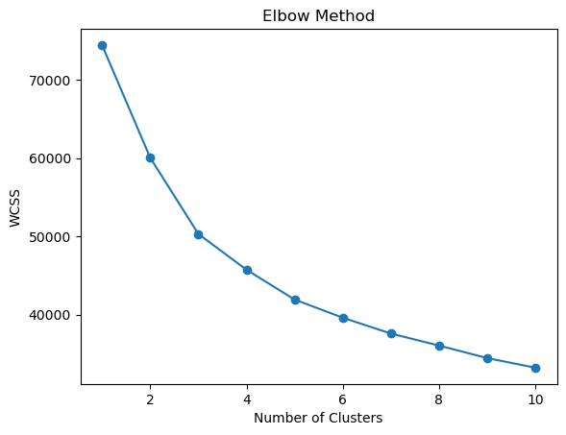
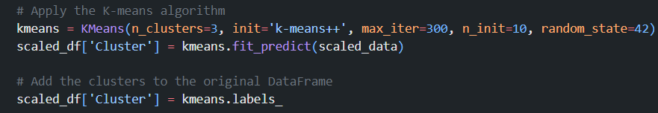
K-means Model To Form Clusters
K value = 3
Cluster column is added in the dataframe.
Cluster 2 ha maximum items and cluster 0 has minimum items.

Slide 22
Evaluation Metrics
MAE (Mean Absolute Error) - is the average error when making a prediction with the model. It is more robust to data with outliers
MSE ( Mean Squared Error) - It is the average squared difference between the estimated values and the actual value.
R-Squared – It shows how well your predictions approximate the real data points.
RMSE stands for Root Mean Squared Error. It's a widely used metric in machine learning to measure the difference between predicted values and actual values. In simpler terms, it tells you how far off your model's predictions are on average.

Slide 23

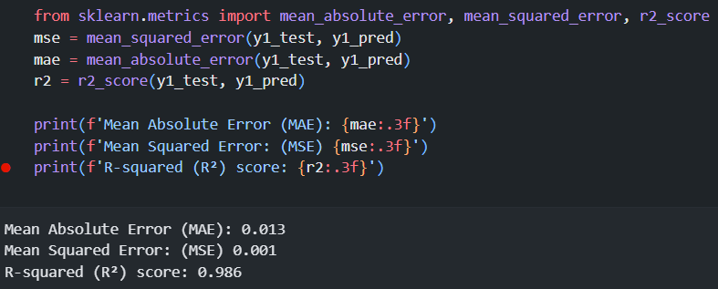
Random Forest Regressor
A Random Forest Regressor is a machine learning algorithm that combines the predictions of multiple decision trees to make a final prediction. It works by building a multitude of decision trees on different subsets of the training data and then averaging their predictions.
Results -

Slide 24
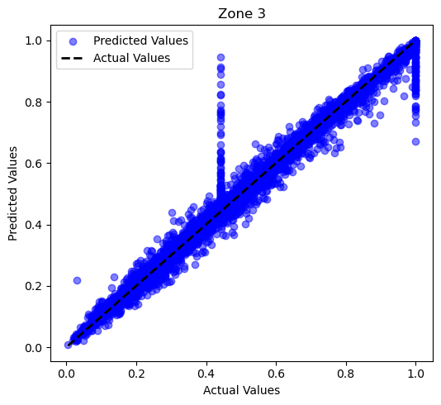
Actual vs Predicted with Best Fit Line using Random Forest Regressor

Slide 25
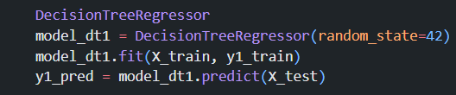
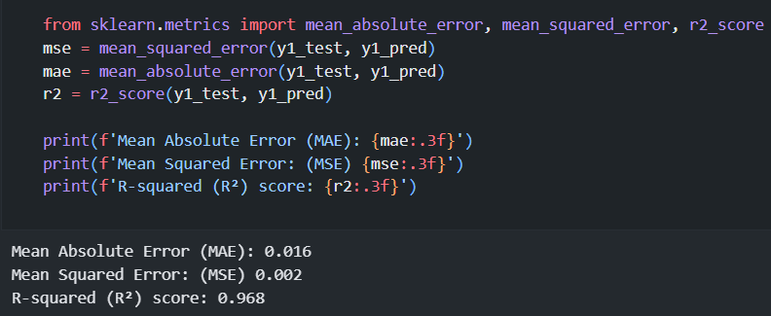
DecisionTree Regressor
A DecisionTree Regressor is a machine learning algorithm used for regression tasks. It constructs a tree-like model where each node represents a feature, and each branch represents a decision based on the feature's value. The tree recursively splits the data based on the feature that best separates the data into groups with similar target values.
Results -

Slide 26
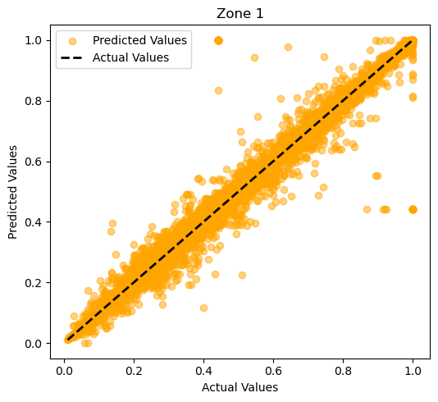
Actual vs Predicted with Best Fit Line using Decision Tree Regressor

Slide 27
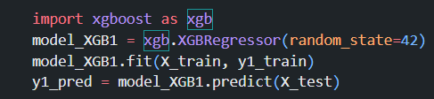
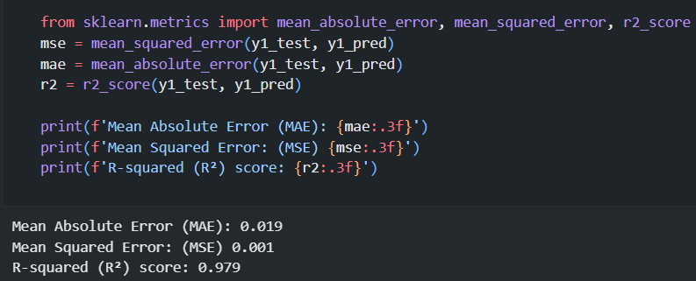
XGBoost
XGBoost (eXtreme Gradient Boosting) is a powerful and efficient machine learning algorithm that builds upon the concept of Gradient Boosting. It's particularly well-known for its performance in a wide range of tasks, including regression.
Results -

Slide 28
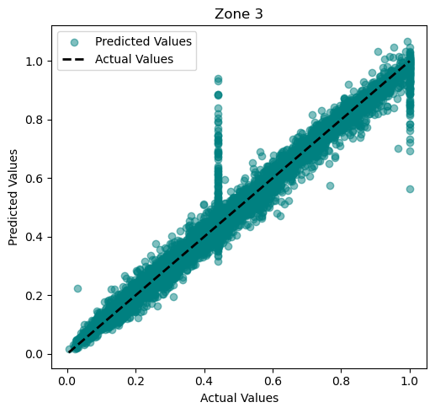
Actual vs Predicted with Best Fit Line using XGBoost Regressor

Slide 29
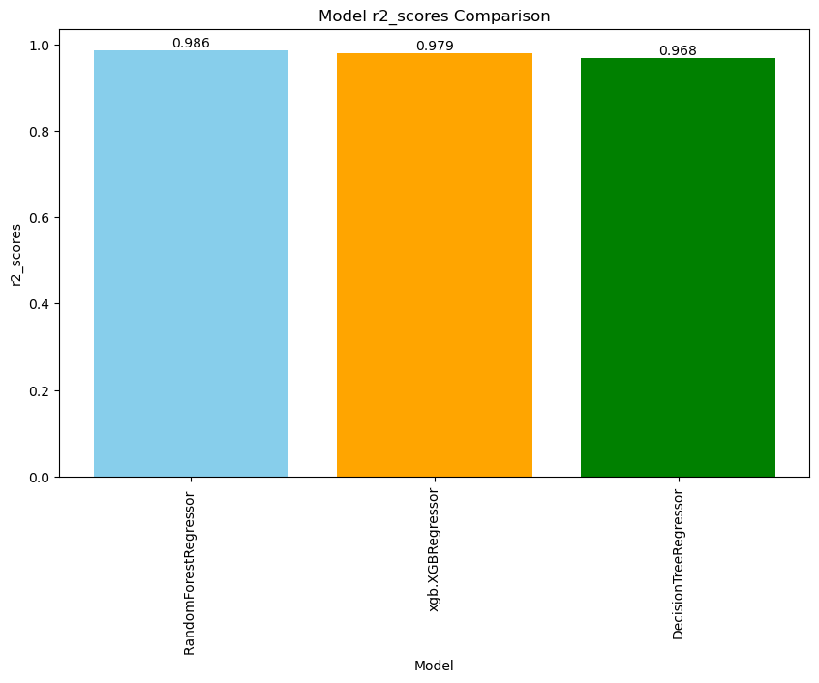
Conclusion
The evaluation of the three regression models (Random Forest, XGBoost, and Decision Tree) using R-squared scores reveals that all models demonstrate strong predictive power, with Random Forest achieving the highest R-squared score. While Random Forest currently exhibits the best performance, a comprehensive model selection process should consider factors beyond R-squared, such as model interpretability, computational cost, and robustness to overfitting.

Slide 30
Thank You!

